Slide 1
Probability Review
“The world is governed by chance. Randomness stalks us every day of our lives.” - Paul Auster

Slide 2
Experiments
A statistical experiment is any controlled repeatable process that results to well-defined outcomes. It is a process that generates a set of data.

Slide 3
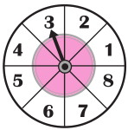
Experiments
A sample space is a set of all possible outcomes of an experiment.

Slide 4
Experiments
A sample space is a set of all possible outcomes of an experiment.
Define the sample space of the given spinning
wheel.

Slide 5
Experiments
A sample space is a set of all possible outcomes of an experiment. An element of the sample space is called a sample point.

Slide 6
Experiments
A sample space is a set of all possible outcomes of an experiment. An element of the sample space is called a sample point. A subset of the sample space is called an event.

Slide 7
Experiments
Define the sample space.
How many elements exist in the sample space?
Let E be the event that the arrow points to an even number. Define the event space of E.
How many elements exist in the event space?

Slide 8

Experiments
Consider a pair of six-sided dice.
Define the sample space.
How many elements exist in the sample space?
Let E be the event that a double is rolled. Define the event space of E.
How many elements exist in the event space?

Slide 9
Events
A simple event is a subset of the sample space with one and only one sample point. A compound event is a subset of the sample space with two or more sample points.

Slide 10
Events
A simple event is a subset of the sample space with one and only one sample point. A compound event is a subset of the sample space with two or more sample points.
A certain event or sure event is an event which is certain to happen. A null event or impossible event is an event that is impossible to happen.

Slide 11
Operations on Events
The complement of an event A is the event containing all sample points in the sample space S that are not contained in A.

Slide 12
Operations on Events
The complement of an event A is the event containing all sample points in the sample space S that are not contained in A.
Let E be the event of getting two heads when a coin is tossed twice. What is the space defined by the complement of event E?

Slide 13
Operations on Events
The union of events A and B is the event containing all sample points in the sample space S that belong to either event A, or event B, or both.
The intersection of events A and B is the event containing all sample points in the sample space S that belong both events A and B.

Slide 14
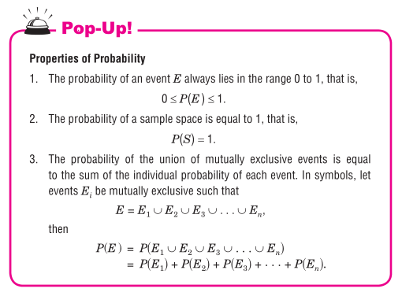
Probability

Slide 15
Probability
There exist three different approaches to probability:

Slide 16
Probability
There exist three different approaches to probability:
A priori Probability
A posteriori Probability
Subjective Probability

Slide 17
The Law of Large Numbers
If an experiment is performed a large number of times, the probability of an event calculated a posteriori will approach the a priori probability.

Slide 18
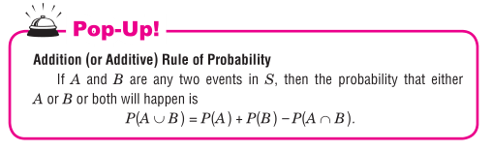
Operations on Probability

Slide 19
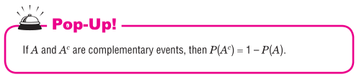
Operations on Probability

Slide 20
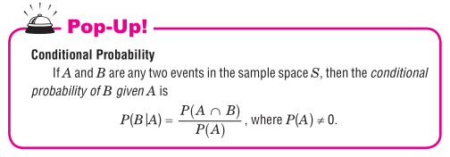
Operations on Probability

Slide 21
Operations on Probability
A six-sided die is rolled. If the number of dots that comes up is odd, what is the probability that it is less than 3?

Slide 22
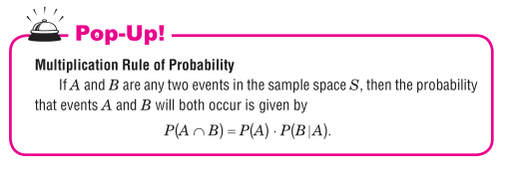
Operations on Probability

Slide 23
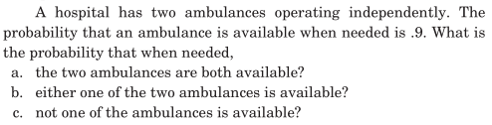
Probability

Slide 24
Probability

